Slide 1
Skincare Recommendation System
-Stuti Gupta(23MCA1002) and Shivani Jain(23MCA1084)

Slide 2
Problem Statement
The main problem is to develop a content-based recommendation system for skincare products that can suggest similar products to a given input product based on their ingredient composition.
The system should be able to preprocess and extract relevant features from the ingredient data, handle high-dimensional data through dimensionality reduction techniques, and compute similarities between products using appropriate distance/similarity metrics.
The recommendation engine should consider factors such as product type and brand to provide relevant and diverse recommendations. Additionally, the system should incorporate interactive visualization components to aid in exploring and understanding the product similarities.
The ultimate goal is to enhance the shopping experience for skincare consumers by providing personalized and informed product recommendations, enabling them to discover new products aligned with their preferences and needs.

Slide 3
Dataset Used and Algorithms Used
Skincare Recommendation Clean Dataset from Kaggle.
Dimensionality Reduction Algorithms:
TruncatedSVD (Truncated Singular Value Decomposition)
TSNE (t-Distributed Stochastic Neighbor Embedding)
Similarity Computation:
Cosine Similarity
Machine Learning Algorithms:
DecisionTreeClassifier
RandomForestClassifier
SVC (Support Vector Classifier)
KNeighborsClassifier
MLPClassifier (Multi-Layer Perceptron)
GradientBoostingClassifier
MultinomialNB (Naive Bayes for Multinomial Models)
LogisticRegression

Slide 4
Methodology
Data Preprocessing
Loading the dataset into a pandas DataFrame
Handling missing values and cleaning the data
Performing string operations to clean and preprocess the ingredient lists
Feature Engineering
Creating a list of unique ingredients from the dataset
Generating a one-hot encoded matrix (ingred_matrix) to represent the presence or absence of each ingredient in each product
Dimensionality Reduction
Using TruncatedSVD (Truncated Singular Value Decomposition) to reduce the feature space to 150 dimensions
Applying t-SNE (t-Distributed Stochastic Neighbor Embedding) to further reduce the dimensions to 2 for visualization purposes
Visualization
Creating an interactive bokeh plot to visualize the product similarities based on the reduced 2D space
Allowing users to filter the plot by product type using a dropdown menu
Data Analysis
Analyzing the product type distribution using a pie chart
Visualizing the price distribution by product type using a box plot
Machine Learning Model Training
Converting the ingredient lists into a format suitable for machine learning
Splitting the data into training and testing sets
Training and evaluating various machine learning models (Decision Tree, Random Forest, SVM, KNN, MLP, Gradient Boosting, Naive Bayes, Logistic Regression) for product type classification

Slide 5
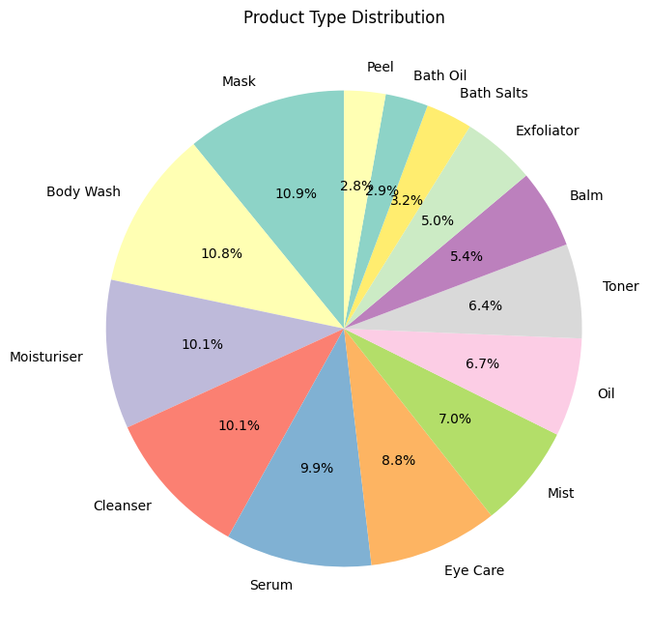
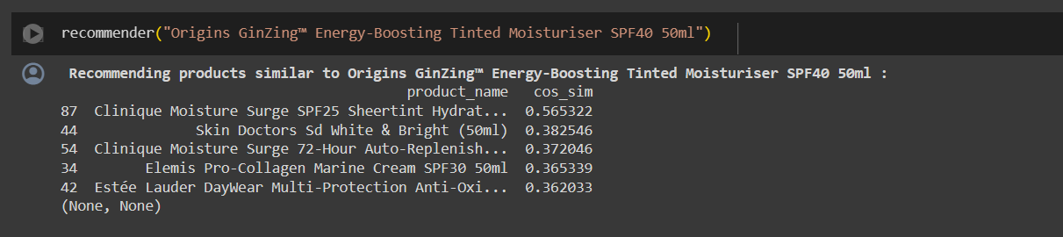
Results
By implementing the model through incorporating the necessary data preprocessing, dimensionality reduction, and brand identification steps, the model achieves the expected result of a content-based recommendation engine for skincare products based on ingredient similarity.

Slide 6

Thank You!

